Slide 1
Vince Graph database
Nhuan To
Department of Electrical and Computer Engineering
University of Alberta
Email: Nhuan@ualberta.ca

Slide 2
Outline
What is a graph database?
Labeled property graph (LPG)
Resource Description Framework (RDF) graph
Question answering system on RDF graph
Q&A

Slide 3
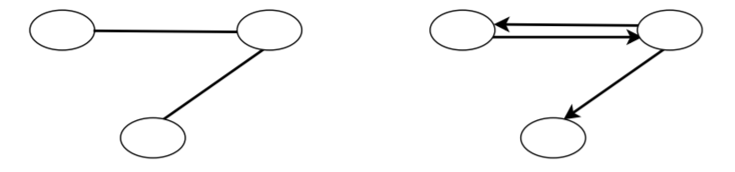
1. What is a graph database?
Question 1: What is a database?
Answer: A database is an organized collection of data, generally stored and accessed electronically from a computer system. (Wikipedia)
Question 2: What is a graph?
Answer: in graph theory, a graph is an order pair G = (V, E) comprising:
V a set of vertices;
E a set of edges (pairs of vertices).
Fig 1. A undirected graph
with three nodes and two edges
Fig 2. A directed graph
with three nodes and three edges
A graph database is a database that uses graph structures to represent and store data. (Wikipedia)

Slide 4
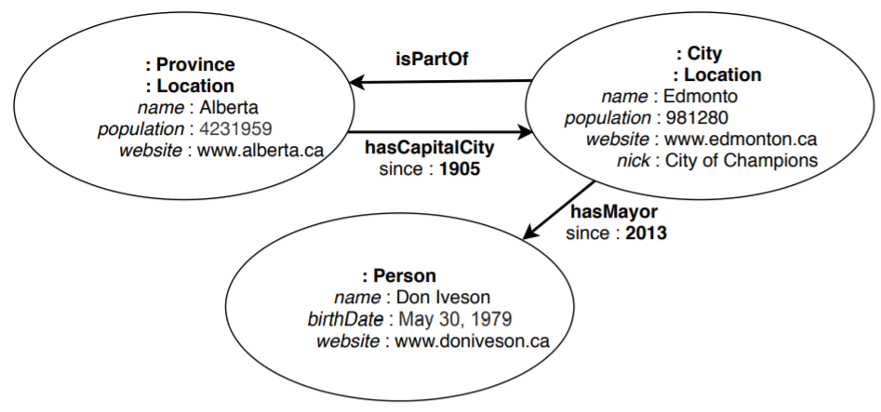
2. Labeled property graph database (LPG)
Nodes are often used to represent entities. A node has a set of property:value pairs and may have label(s).
Edges are often used to represent relationships between entities. A relationship must have exactly one relationship type and may have a set of property:value pairs describes the relationship.
Fig 3. A labeled property graph with three nodes and three edges

Slide 5
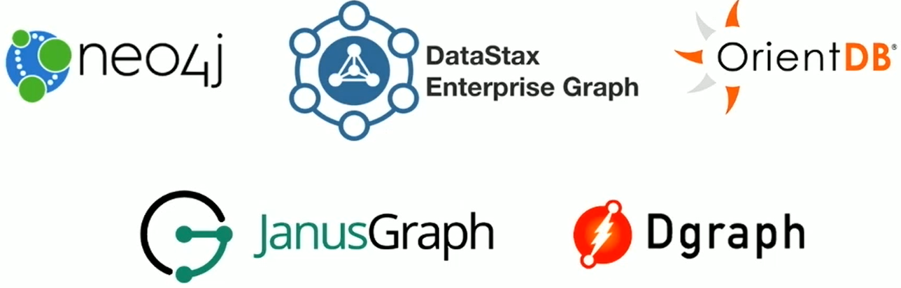
2. Labeled property graph database (continue)
Query languages: Cypher, GQL, PGQL, Gremlin
A example of Cypher query in neo4j:
Match (city:City)-[:isPartOf]->(:Province{name:Alberta}) Return city
LPG datastores:
Fig 4. Property graph datastores
(source: What are Graph Databases and Why should I care? - Dave Bechberger)

Slide 6

3. Resource Description Framework (RDF) graph
RDF was originally created in early 1999 by World Wide Web Consortium (W3C) as a standard for encoding metadata about Web resources.
A resource is described by a list of statements, and each statement takes the form of Subject-Predicate-Object.
The subject is the name of the resource.
The predicate denotes one of traits or aspects of the resource. It is also called property.
The object is the property’s value.
Fig 4. Graph structure of a RDF statement

Slide 7
3. RDF graph (continue..)
The name of a resource must be global and should be identified by Uniform Resource Identifier (URI).
The name of predicate must also be global and should be identified by URI as well.
Fig 5. Graph structure of a RDF statement in DBpedia
Fig 6. Graph structure of a RDF statement in Dbpedia using XML’s QName
Notes:
if we use URIs to represent resources, all the resources will inevitably have fairly long names. This is not quite convenient and not quite readable either.
The solution is: a full URI is usually abbreviated
by replacing it with its XML qualified name (QName). QName contains a prefix that maps to a namespace URI, followed by a colon and then a local name. For example, http://dbpedia.org/resource/Edmonton -> dbr:Edmonton

Slide 8
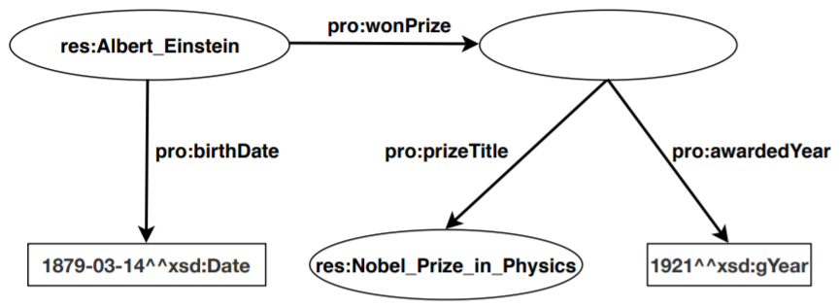
3. RDF graph (continue..)
If a resource is not identified by a URI, the node repressing the resource in RDF graph is called a blank node (Bnode).
Fig 7. RDF Graph containing a blank node
Notes:
if we use URIs to represent resources, all the resources will inevitably have fairly long names. This is not quite convenient and not quite readable either.
The solution to this issue is quite straightforward: a full URI is usually abbreviated
by replacing it with its XML qualified name (QName). QName contains a prefix that maps to a namespace URI, followed by a colon and then a local name. For example, http://dbpedia.org/resource/Edmonton -> dbr:Edmonton

Slide 9
3. RDF graph (continue..)
3.1. RDF schema
RDF refers a set of URIs to an RDF vocabulary.
RDFS is recommendation from W3C and it is a language that one can use to create a vocabulary for describing classes, subclasses and properties of RDF resources. It provides
rdfs:label
rdfs:comment
rdfs:domain
rdfs:range
…

Slide 10
3. RDF graph (continue..)
3.2. Ontology and Web Ontology Language (OWL)
An ontology formally defines a common set of terms that are used to describe and represent a domain.
Ontology is domain-specific
Ontology contains terms (classes, properties) and the relationships among these terms.
OWL is a language to use when creating ontologies.
Has same purpose as RDF Schema
OWL = RDF Schema + new constructs for better expressiveness
Some predefined ontologies:
Schema.org: a well accepted ontology for common things in life founded by Google, Microsoft, Yahoo and Yandex.
FOAF: a machine-readable ontology describing persons, their activities and their relations to other people and objects
…
Notes:
- Ontology is domain-specific, and it is used to describe and represent an area of knowledge.
- A domain is simply a specific subject area or area of knowledge, such as the area of
photography, medicine, real estate, education, etc.
- Ontology contains terms and the relationships among these terms. Terms
are often called classes, or concepts, and these words are interchangeable.
The relationships between these classes can be expressed by using a hierarchical
structure: super-classes represent higher-level concepts, and subclasses represent
finer concepts. The finer concepts have all the attributes and features that the higher
concepts have. Besides the above relationships among the classes, there is another level of relationship expressed by using a special group of terms: properties. These
property terms describe various features and attributes of the concepts, and they
can also be used to associate different classes together. Therefore, the relationships
among classes are not only super-class or subclass relationships, but also relationships expressed in the term of properties.

Slide 11
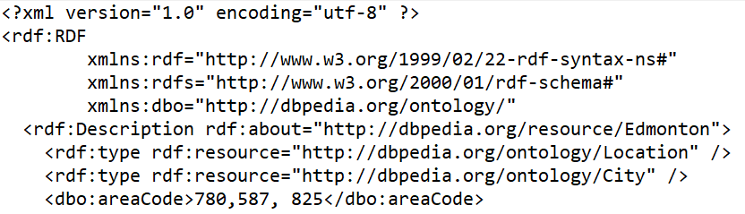
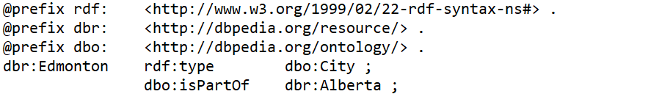
3. RDF graph (continue..)
3.3. RDF Serialization
Provide syntax for syntax for creating and reading concrete RDF data.
RDF/XML: represents an RDF graph as an XML document.
Turtle: a compact, human-friendly format.
Other RDF serializations: Notation 3 (N3), RDF/JSON, JSON-LD, N-Triples, N-Quads
Notes:
if we use URIs to represent resources, all the resources will inevitably have fairly long names. This is not quite convenient and not quite readable either.
The solution to this issue is quite straightforward: a full URI is usually abbreviated
by replacing it with its XML qualified name (QName). QName contains a prefix that maps to a namespace URI, followed by a colon and then a local name. For example, http://dbpedia.org/resource/Edmonton -> dbr:Edmonton

Slide 12
3. RDF graph (continue..)
3.4. RDF query language: SPARQL
Is a SQL-like query language for RDF graph data provides 6 main query types:
SELECT which returns tabular results.
CONSTRUCT creates a new RDF graph.
ASK which returns ‘yes’ if the query has a solution, otherwise, ‘no’.
DESCRIBE which return RDF graph data about a resource.
INSERT which inserts triples into a graph.
DELETE which deletes triples from a graph.
Example:
SELECT DISTINCT ?city
WHERE {?city rdf:type dbo:City. ?city dbo:isPartOf dbr:Alberta.}

Slide 13
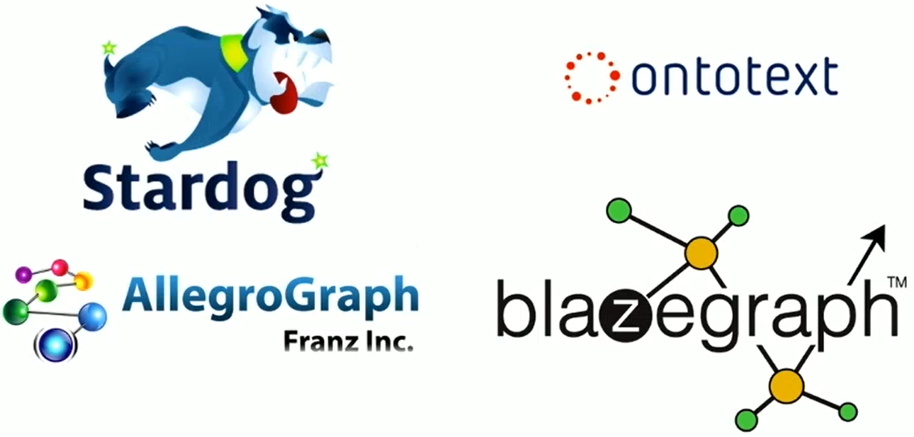
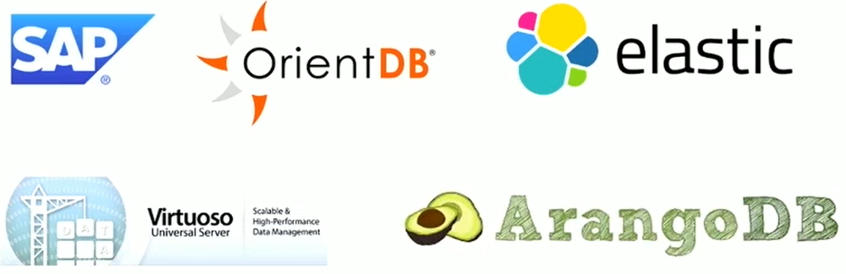
3. RDF graph (continue..)
3.5. RDF datastores
RDF datastores:
Fig 7. RDF datastores
(source: What are Graph Databases and Why should I care? - Dave Bechberger)
Fig 8. Multi-model datastores
(source: What are Graph Databases and Why should I care? - Dave Bechberger)

Slide 14
4. Question answering system on RDF graph
Take a natural language question from user.
Translate the question into a SPARQL query.
Send the query to SPARQL endpoint (DBpedia/Wikidata)
Get the query result and represent it to the user.

